Slide 1

Risk management in software development
Thirteenth group：朱云龙，何鹏程
陈柏山，梁俊杰

Slide 2

content
Overview of software risk management
The main process of software risk management
Model approach to software risk management
conclusion

Slide 3
Risk manage
What is risk management?
The process of risk management？
How to manage risk ？

Slide 4
What is software risk management?
The concept of risk management ：
Software risk management refers to the process of continuously identifying, evaluating and monitoring risks in the process of the project, with the purpose of reducing the adverse impact of risks on the project 。

Slide 5
What is software risk management?
The role of risk management ：
Effective risk management can improve the success rate of projects
Risk management can increase team robustness
Effective risk management helps project managers focus their efforts on significant risks.

Slide 6
Passive and active risk strategies
Passive risk strategy ：
Passive risk strategies monitor projects for potential risks, allocate resources to deal with them only when they become real problems, and more generally, act quickly to try to correct them quickly after they occur。
Active risk strategy ：
Active strategies are initiated long before technical work begins, identifying potential risks, assessing their probability of occurrence and impact, prioritizing the importance of the risks, and then the software project team establishes a plan to manage the risks. The primary goal of an active risk management strategy is to prevent risk.

Slide 7
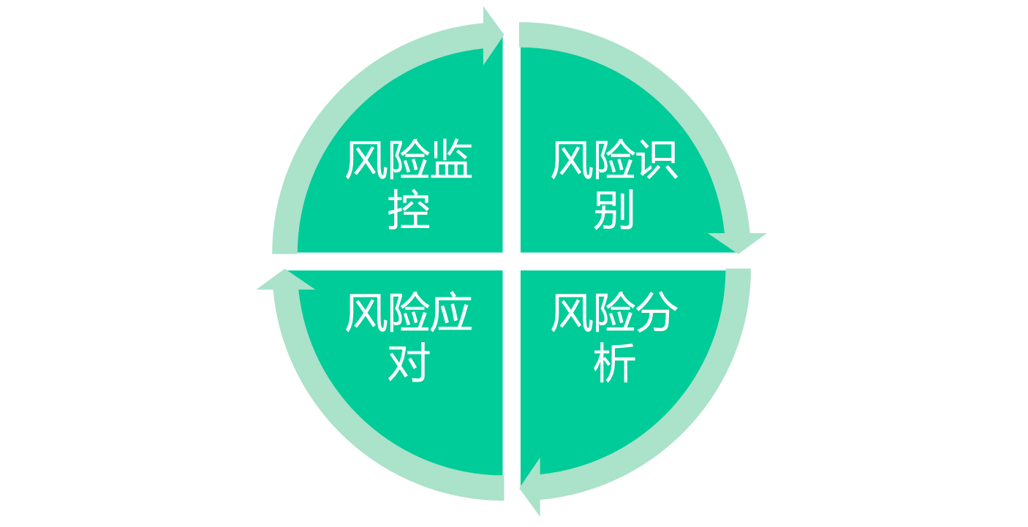
The main process of risk management
Risk management is a cyclical process

Slide 8
Risk identification
The process of risk identification
输入
风险识别方法
输出
This includes determining the source of risks, the conditions under which risks are generated, describing their risk characteristics and determining which risk events are likely to affect the project.
目标
流程
制度
技术
资源
人员等
风险识别活动
风险信息列表

Slide 9
Risk analysis
The process of risk analysis
It involves the assessment of risks and their interactions. It is a process to measure the probability of risks and the degree of risk's impact on the project
输入
评估分析方法
输出
项目描述
度量单位
技术方法
评估流程
支持资源
历史数据等
风险评估活动
评估分析报告

Slide 10
Risk analysis table
排序
输入
风险事件
可能性
影响
风险值
采取的措施
1
系统设计评审
没有足够的时间进行产品测试
70%
50%
35%
2
WBS
对需求的开发式系统标准没有合适的测试案例
20%
80%
16%
3
需求和计划
采用新技术可可能导致进度的延期
50%
30%
15%
……

Slide 11
Risk response
The process of risk response
输入
风险应对策略
输出
After the risks have been identified and analysed, they must be appropriately addressed. Risk coping strategies include risk avoidance, risk acceptance, risk transfer, risk mitigation, etc.
风险列表
风险评估报告
风险评估活动
风险应对计划

Slide 12
Risk avoidance （1/4）
Risk avoidance is to avoid the possible risks as much as possible, and take the initiative to give up or refuse to use the program that leads to the risk.
Such as giving up on new technology.
Eliminate the cause of risk and reduce the probability of risk occurrence to zero. Has the advantage of simplicity and thoroughness.

Slide 13
Risk acceptance （2/4）
Project teams consciously choose to take the risk and the consequences themselves.
When the risk is difficult to avoid, or the cost of adopting other risk solutions exceeds the loss caused by the occurrence of the risk, the risk acceptance strategy can be adopted.

Slide 14
Risk transfer （3/4）
Transfer risk is to avoid the risk of loss, consciously loss or loss related to the financial consequences of the transfer out of the method. Risk transfer is often used to deal with the outbreak of financial storms.

Slide 15
Risk mitigation （4/4）
Before the risk occurs, take some measures to reduce the possibility of risk occurrence or reduce the possible loss caused by risk.
For example, in order to prevent staff turnover, improve the treatment of staff, improve the working environment; Backup to prevent program or data loss, etc.

Slide 16
项目风险管理计划
序号 | 风险识别 |  | 风险分析 |  |  | 风险应对措施
 | 潜在的风险事件 | 风险发生的后果 | 可能性 | 影响 | 风险值 | 应对措施 | 预防措施 | 负责人
1 | 需求不明确 | 客户不接受产品或拒绝付款 | 50% | 80% | 40% | 派遣经验丰富的需求分析师与客户进行深入的交流，明确客户的主要需求，引导客户对项目做出正确的描述。 | 事先进行需求评审
2 | 软件功能漏项 | 客户不满意 | 30% | 80% | 24% | 增加相应的功能 | 进行设计评审、获得客户确认

Slide 17
Risk control
The process of risk response
输入
风险监控方法
输出
The purpose is to test whether the actual effect of risk management strategy and moisture is consistent with the prediction, and to get feedback to improve the plan and management.
风险管理计划
风险管理活动
风险管理计划的更新

Slide 18
Risk control
The methods of risk response
Periodic review and process review
Risk reassessment
Earned value analysis

Slide 19
Risk management model
Boehm model
风险管理
风险评估
风险控制
风险识别
风险分析
风险优先级
风险管理计划
风险化解
风险监控

Slide 20
Risk management model
Boehm model
Boehm's core idea is a list of 10 major risk factors, including staff shortages, unreasonable schedules and budgets, and changing needs. Summarize the specific risk factors of the current project, plan and implement after assessment, summarize the solution of the 10 risk factors at the next regular meeting, generate a new table of the 10 risk factors, and so on.

Slide 21
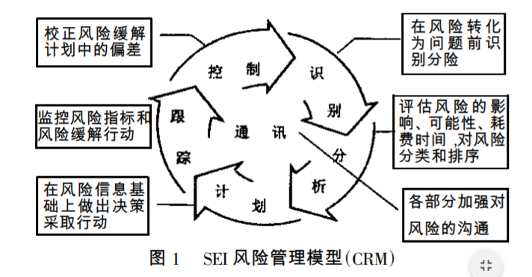
Risk management model
CRM model： The CRM model proposed by SEI requires a focus on risk identification and management at all stages of the project lifecycle.

Slide 22
Risk management model
CRM model：
The most obvious feature of SEI's CRM model is its close integration with the software development process and its strong operability. The CRM model takes the risk management process as the main body and emphasizes the management steps. It believes that this is a continuous and repeated activity in the development of a project. However, due to the high cost of using this model, it is more suitable for large companies or large projects.

Slide 23
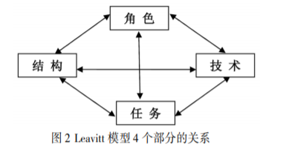
Risk management model
Leavitt model: Software project management as a system, and the system is divided into four parts: roles, tasks, structure and technology.

Slide 24
Risk management model
Leavitt model
Role – technology: Don't select people who are technically incompetent or overly competent;
Technology - task :It is not appropriate to choose technologies that meet the requirements of the task, are low in performance or are too advanced to achieve difficult technologies.
task-structure: Wrong organization structure or requirements can not achieve the task;

Slide 25
Risk management model
Leavitt model
Structure – role: Wrong appointments between people, wrong assignments of w and wrong behaviour can be risky;
Roles -- tasks: When selecting people for a task, it is important to select people whose ability matches the task.
Technology -- structure: Select the appropriate technology and the corresponding specifications, requirements and other structures.

Slide 26
Risk management model
Leavitt model
Leavitt model studies risk management from the perspective of system, with simple operation, perfect definition and good inclusiveness. Therefore, at present, this design method and implementation research have been widely used in various literature and information systems. Leavitt model has the characteristics of defining and analyzing risk management steps

Slide 27

summary
All kinds of possible risks in the project must be managed
Know what the risks are
How to mitigate and eliminate risks and how to deal with risks when they occur
Monitor risks during project implementation

Slide 28
Thank you for listening

